Slide 1
Assessing the structure of UK environmental concern and its association with pro-environmental behaviour
Mark Elliot
Rebecca Rhead
Paul Upham

Slide 2
Outline
A bit of theory
Our approach
Results
Some thoughts

Slide 3
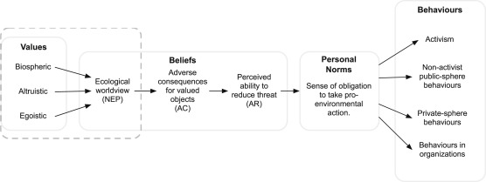
Prevailing Theory
Values Beliefs and Norms
Stern et al

Slide 4
Some concerns
Empirical work has largely appeared to have validated the theory
But it seems an open to question as theory and instrument are often conflated in these studies
If you use your theory to design a survey, then it’s no great surprise if your theoretical structure emerges from your survey

Slide 5
Our RQs
Can and do theoretically familiar EC constructs emerge from large scale environmental attitude and behaviour survey data without the use of strict EC scales?
If so, are recognisable NEP/VBN components evident when using a nationally representative British sample, given the originally US basis of the above?
What is the value of an ontological distinction between attitudes and reported behaviours in this context?
How do environmental attitudes relate to behaviour in such a dataset?

Slide 6
Data
DEFRA's ‘Survey of Public Attitudes and Behaviours towards the Environment’
The 2009 wave of EAS is used, with a sample size of 2929 British participants.

Slide 7
10 Likert scale questions selected
Variable name Statement
Major disaster If things continue on their current course, we will soon experience a major environmental disaster
Limited resources The Earth has very limited room and resources
Crisis exaggerated The so-called ‘environmental crisis’ facing humanity has been greatly exaggerated
Too far in future The effects of climate change are too far in the future to really worry me
Over-populated We are close to the limit of the number of people the earth can support
Changes to countryside I do worry about the changes to the countryside in the UK and the loss of native animal and plants.
Loss of animal species I do worry about the loss of animal species and plants in the world
Beyond control Climate change is beyond control – it's too late to do anything about it
Low priority The environment is a low priority compared to other things in my life

Slide 8
Methods
Exploratory and confirmatory factor analyses used
Exploratory factor analyses
Maximum likelihood factoring
Parallel analysis used for determining factor retention
CFA followed to test the model that emerged from the EFA.

Slide 9
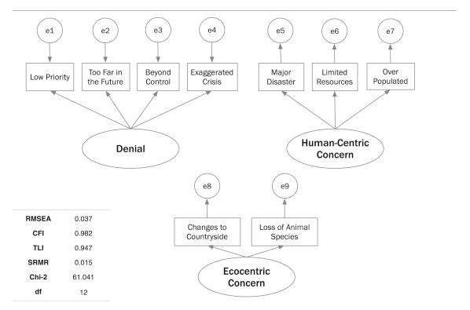

Slide 10
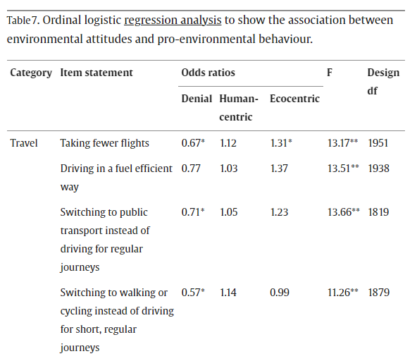

Slide 11
Discussion
VBN type factors to broadly emerge from the data
The three factors that that emerge throw up something else

Slide 13
Rhead, R., Elliot, M. and Upham, P., 2015. Assessing the structure of UK environmental concern and its association with pro-environmental behaviour. Journal of Environmental Psychology, 43, pp.175-183.
Rhead, R., Elliot, M. and Upham, P., 2018. Using latent class analysis to produce a typology of environmental concern in the UK. Social Science Research, 74, pp.210-222.
Liu, T., Shryane, N. and Elliot, M., 2022. Attitudes to climate change risk: classification of and transitions in the UK population between 2012 and 2020. Humanities and Social Sciences Communications, 9(1), pp.1-15.

